Slide 1
Momentum Conservations Notes

Slide 2
Momentum Conservation Principle
One of the most powerful laws in physics is the law of momentum conservation.
For a collision occurring between object 1 and object 2 in an isolated system, the total momentum of the two objects before the collision is equal to the total momentum of the two objects after the collision.

Slide 3
The law of conservation of momentum states that, in the absence of an external force, the momentum of a system remains unchanged.
In every case, the momentum of a system cannot change unless it is acted on by external forces.
When any quantity in physics does not change, we say it is conserved.

Slide 4
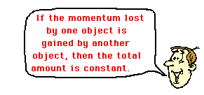
Momentum Conservation Calculation
net P_{before} = net P_{after}

Slide 5
Examples

Slide 6
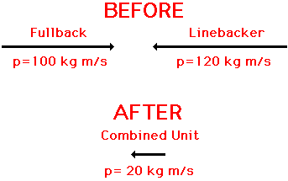
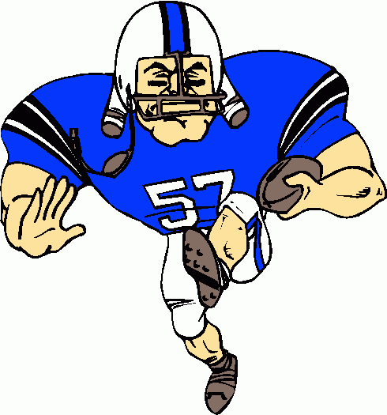
Examples

Slide 7
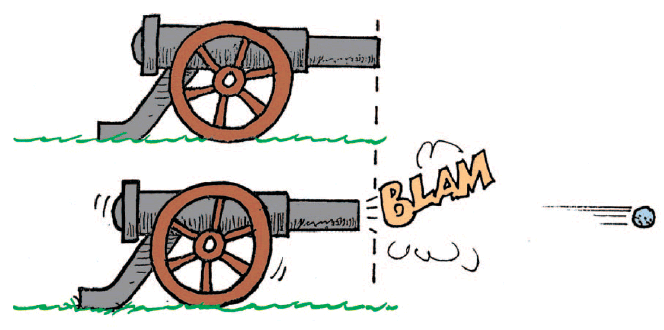
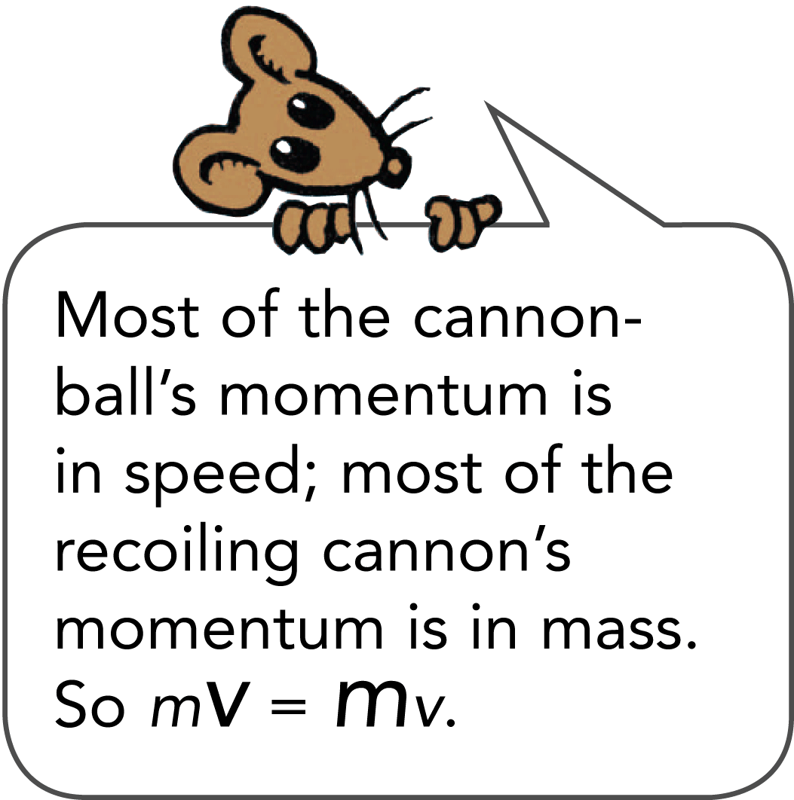
Cannon Example
The momentum before firing is zero. After firing, the net momentum is still zero because the momentum of the cannon is equal and opposite to the momentum of the cannonball.
The force on the cannonball inside the cannon barrel is equal and opposite to the force causing the cannon to recoil. The action and reaction forces are internal to the system so they don’t change the momentum of the cannon-cannonball system.
Before the firing, the momentum is zero.
After the firing, the net momentum is still zero.
Net momentum is neither gained nor lost.

Slide 8
Elastic Collisions
When a moving billiard ball collides head-on with a ball at rest, the first ball comes to rest and the second ball moves away with a velocity equal to the initial velocity of the first ball.
Momentum is transferred from the first ball to the second ball.
When objects collide without being permanently deformed and without generating heat, the collision is an elastic collision.
Colliding objects bounce perfectly in perfect elastic collisions.
The sum of the momentum vectors is the same before and after each collision.

Slide 9
Elastic Collisions Calculation
net P_{before} = net P_{after}
(m₁v₁ + m₂v₂) _{before} = (m₁v₁ + m₂v₂) _{after}

Slide 10
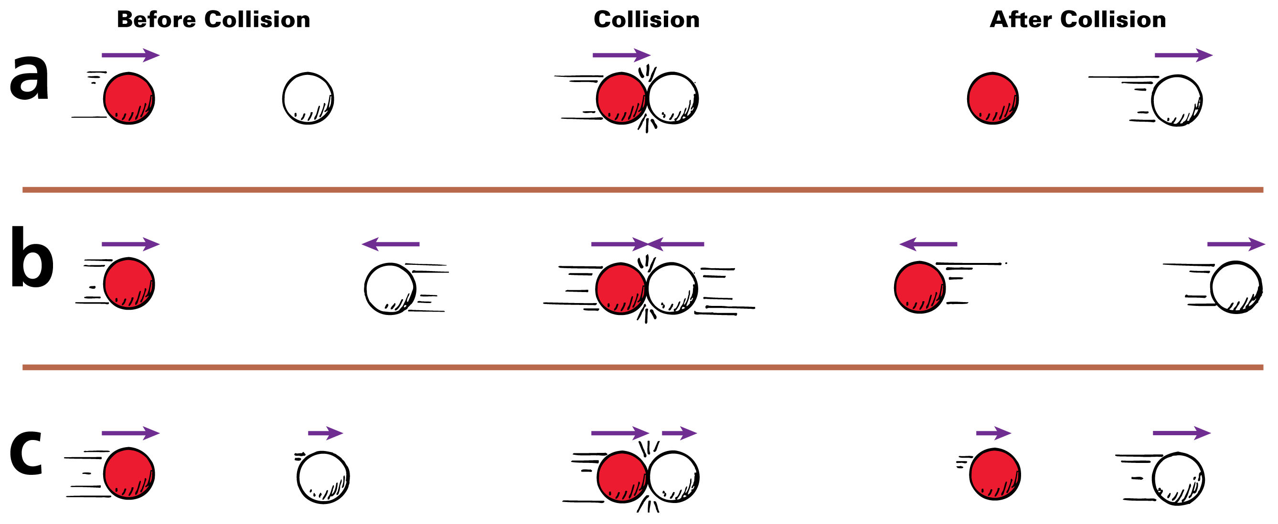
Elastic Collisions Samples
A moving ball strikes a ball at rest.
Two moving balls collide head-on.
Two balls moving in the same direction collide.

Slide 11
Inelastic Collisions
A collision in which the colliding objects become distorted and generate heat during the collision is an inelastic collision.
Momentum conservation holds true even in inelastic collisions.
Whenever colliding objects become tangled or couple together, a totally inelastic collision occurs.

Slide 12
Inelastic Collisions Calculation
net P_{before} = net P_{after}
(m₁v₁ + m₂v₂) _{before} = (m_{T}v_{T}) _{after}

Slide 13
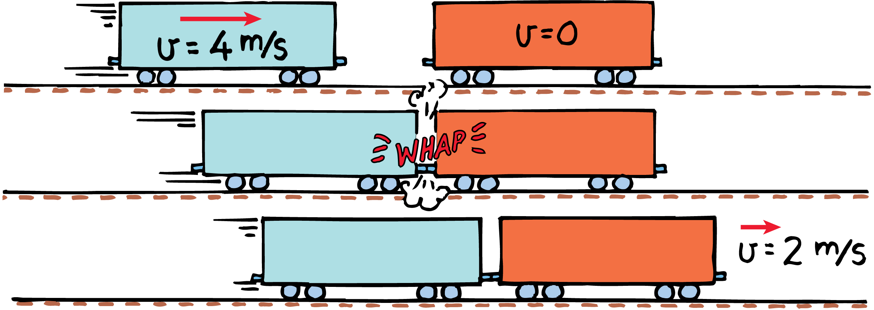
Inelastic Collisions Sample
Freight Car Example
In an inelastic collision between two freight cars, the momentum of the freight car on the left is shared with the freight car on the right.

Slide 14
Freight Car Example
The freight cars are of equal mass m, and one car moves at 4 m/s toward the other car that is at rest.
net momentum _{before collision} = net momentum _{after collision}
(net mv)_{before} = (net mv)_{after}
(m)(4 m/s) + (m)(0 m/s) = (2m)(v_{after})
Twice as much mass is moving after the collision, so the velocity, v_{after}, must be one half of 4 m/s.
v_{after} = 2 m/s in the same direction as the velocity before the collision, v_{before}.

Slide 15
think!
One glider is loaded so it has three times the mass of another glider. The loaded glider is initially at rest. The unloaded glider collides with the loaded glider and the two gliders stick together. Describe the motion of the gliders after the collision.
Answer: The mass of the stuck-together gliders is four times that of the unloaded glider. The velocity of the stuck-together gliders is one fourth of the unloaded glider’s velocity before collision. This velocity is in the same direction as before, since the direction as well as the amount of momentum is conserved.

Slide 16

do the math!
Consider a 6-kg fish that swims toward and swallows a 2-kg fish that is at rest. If the larger fish swims at 1 m/s, what is its velocity immediately after lunch?

Slide 17
do the math!
Consider a 6-kg fish that swims toward and swallows a 2-kg fish that is at rest. If the larger fish swims at 1 m/s, what is its velocity immediately after lunch?
Momentum is conserved from the instant before lunch until the instant after (in so brief an interval, water resistance does not have time to change the momentum).

Slide 18
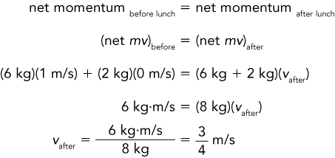
do the math!

Slide 19
do the math!
Suppose the small fish is not at rest but is swimming toward the large fish at 2 m/s.

Slide 20
do the math!
Suppose the small fish is not at rest but is swimming toward the large fish at 2 m/s.
If we consider the direction of the large fish as positive, then the velocity of the small fish is –2 m/s.

Slide 21
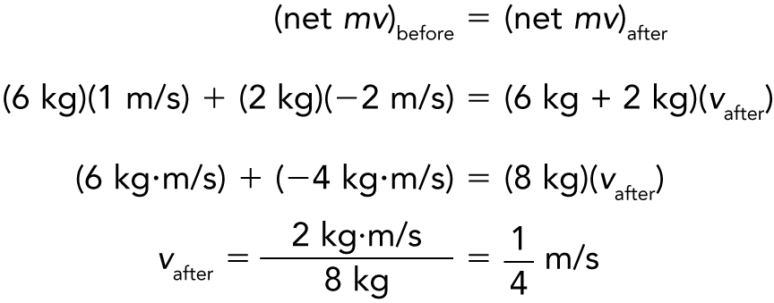
do the math!
The negative momentum of the small fish slows the large fish.

Slide 22
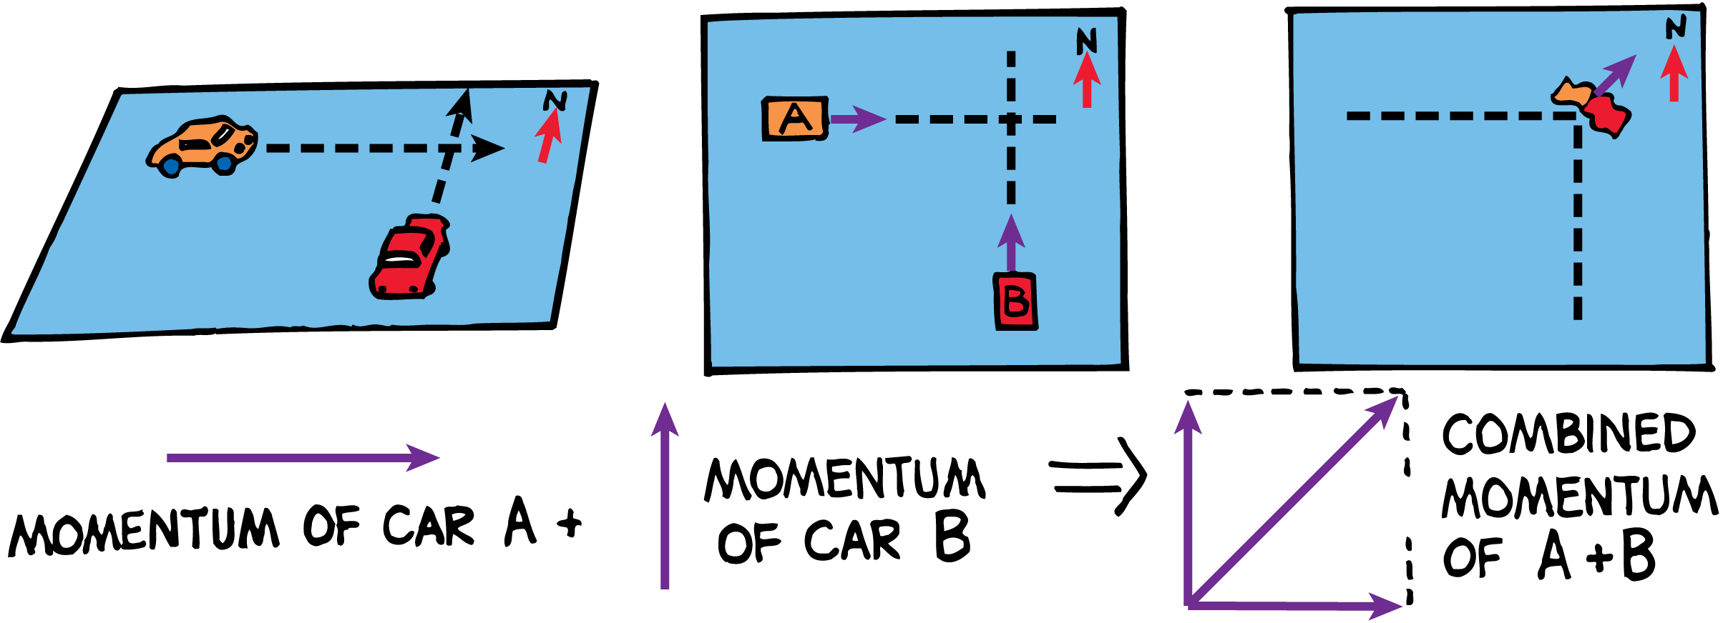
Momentum Vectors
Momentum is a vector quantity.
The momentum of the wreck is equal to the vector sum of the momentum of car A and car B before the collision.

